Slide 1
Classic Cafe
(Data Pirates)
Group Members:
Arshpreet Singh
Gurkirat Kaur
Ravneet Kaur
Prabhpreet Singh
Notes:
Intro

Slide 2

Need for The System
The web application would help:
To Increase productivity and efficiency of café in serving the customers.

Slide 3
Target Users
Youngsters
Working
Elderly

Slide 4
About Web Application
Easily Available in the market.
Supported by all Web browsers with latest version.
Easily Affordable by Client

Slide 5
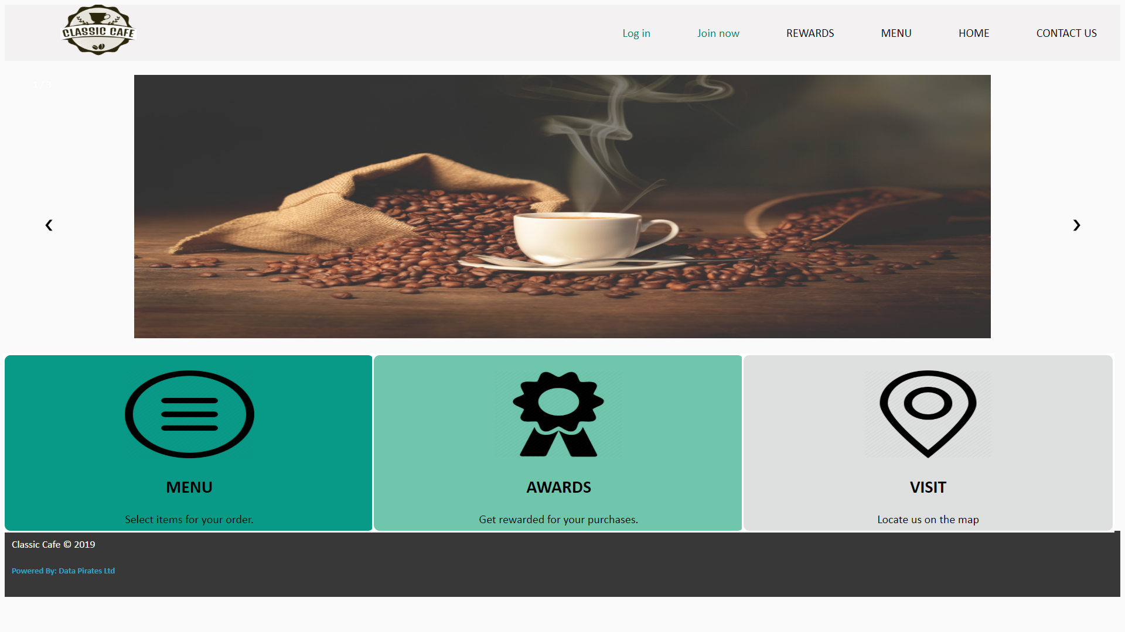


System Description
CUSTOMER
CLASSIC CAFE
Customer will order through the website

Slide 7
The Whole Process
Order
(User select from the menu which is added to the cart when PURCHASE is successfully done.)
Sign In/Up
(Input value gets stored in database.)
Rewards
( ‘Purchase value’ increases by 1 .
But If ‘Purchase value’ = 7 after current purchase, then ‘rewards value’ increases by 1 & ‘Purchase value’ becomes 0. )
Profile Opens
(Data is extracted from database and rewards are shown)

Slide 8
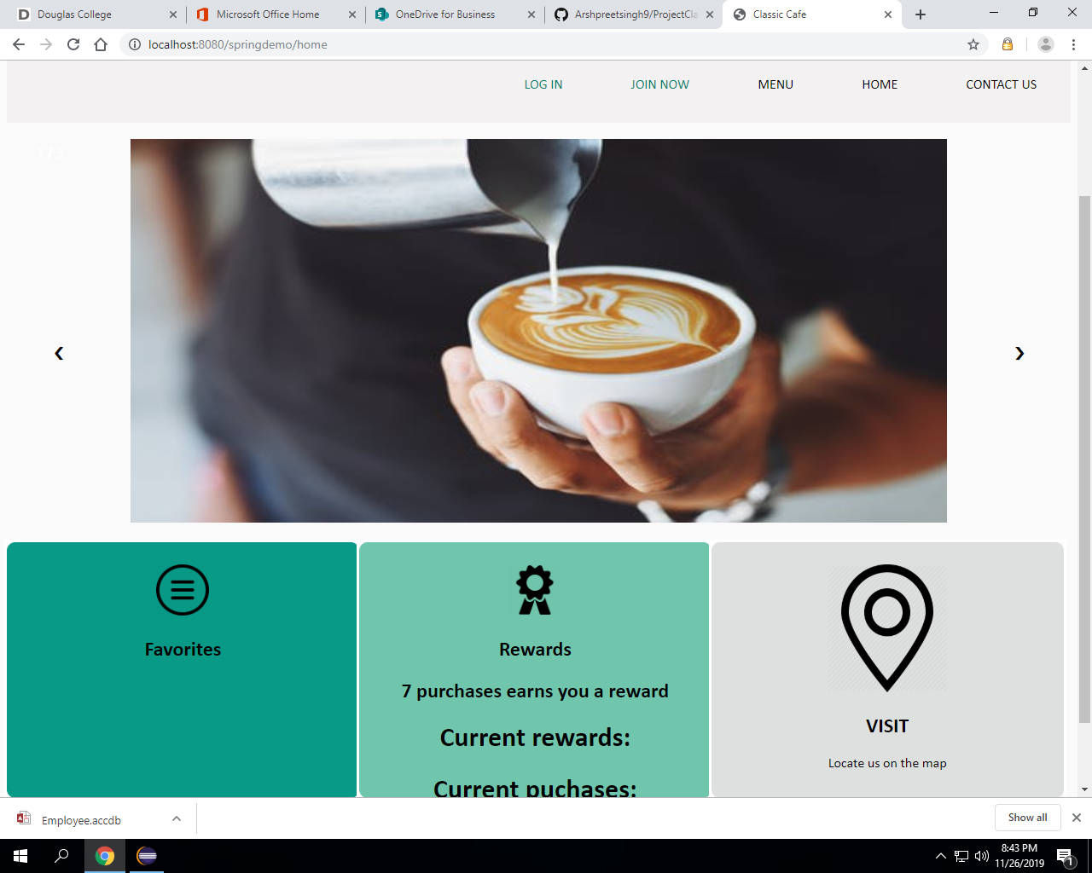
Home : The user need to go to login first to see the rewards.

Slide 9
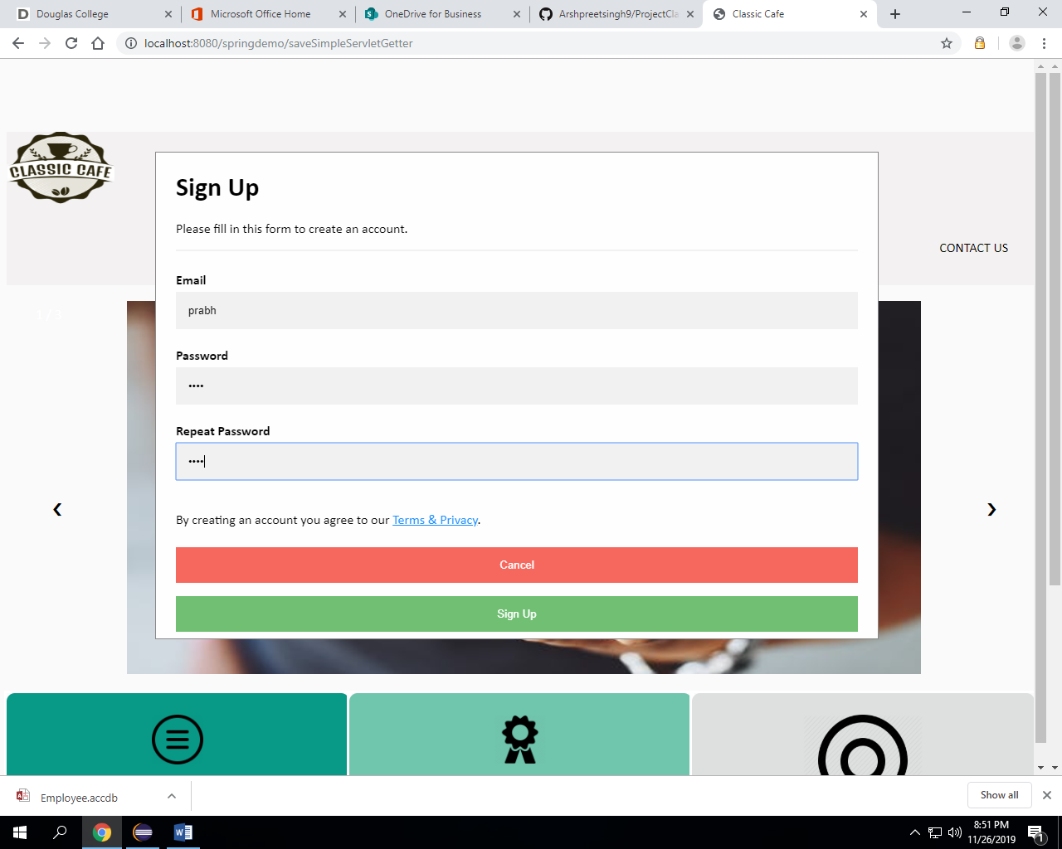
Sign up: data goes into our database when a user sign up and becomes a customer and get 1 rewards from us.

Slide 10
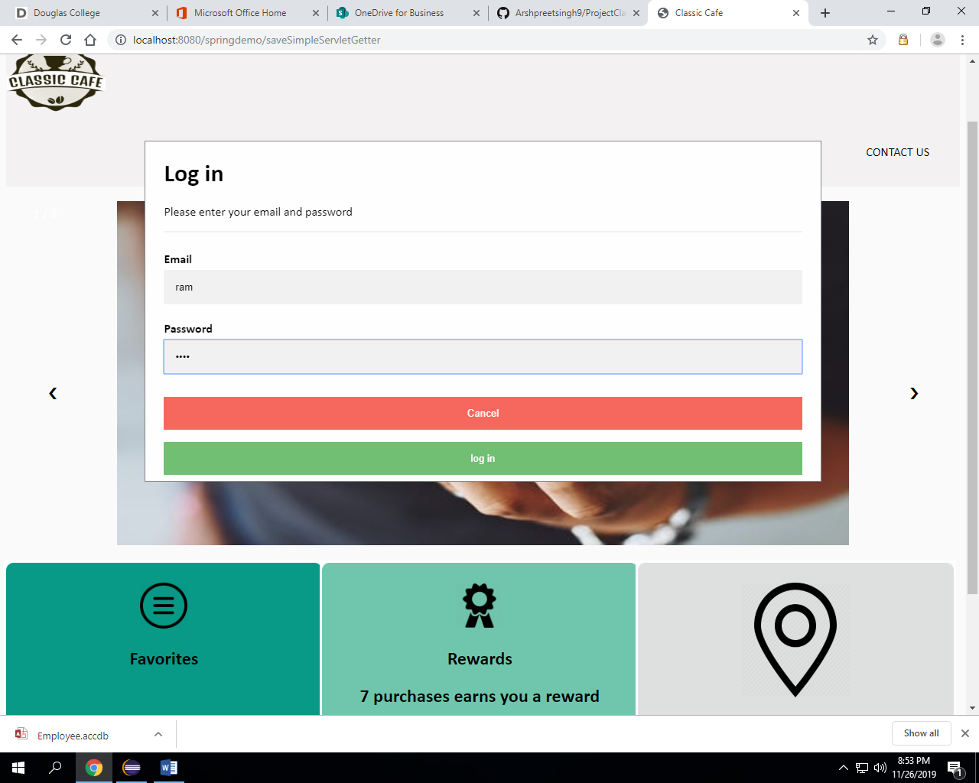
Login:

Slide 11
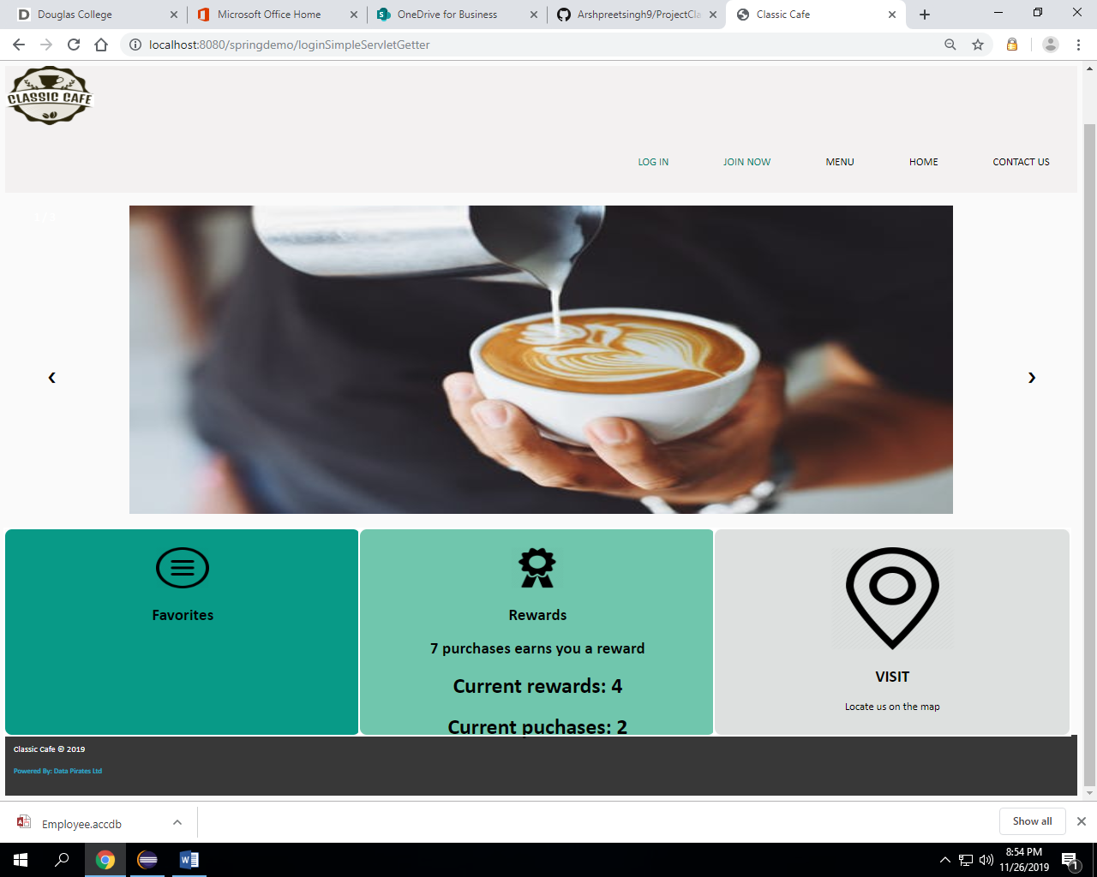
Page after logging in: customer could see his or rewards and purchases:

Slide 12
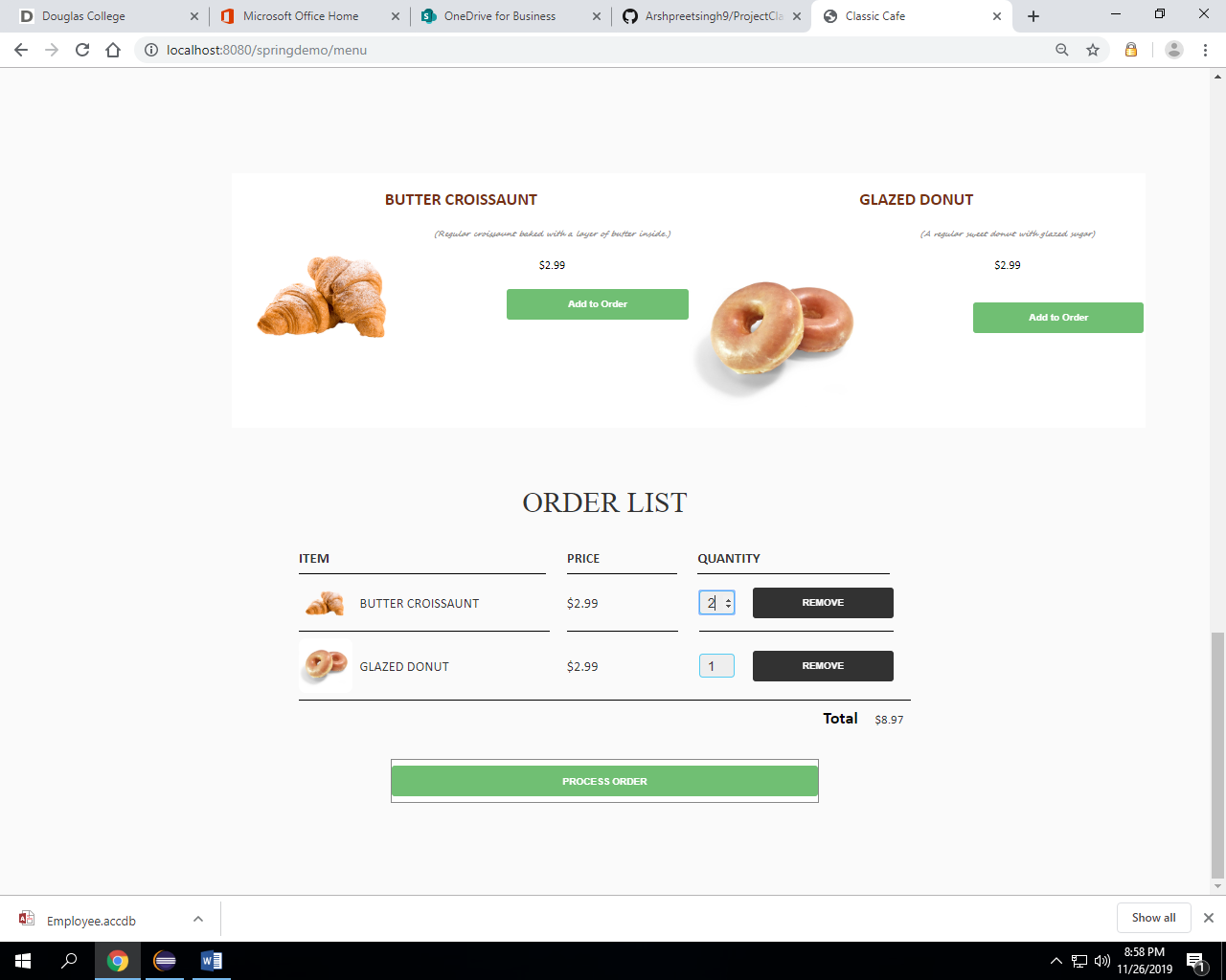
Menu: logged in persons purchases increases and if becomes 7 then reward increases by 1 and purchases get to 1:

Slide 13
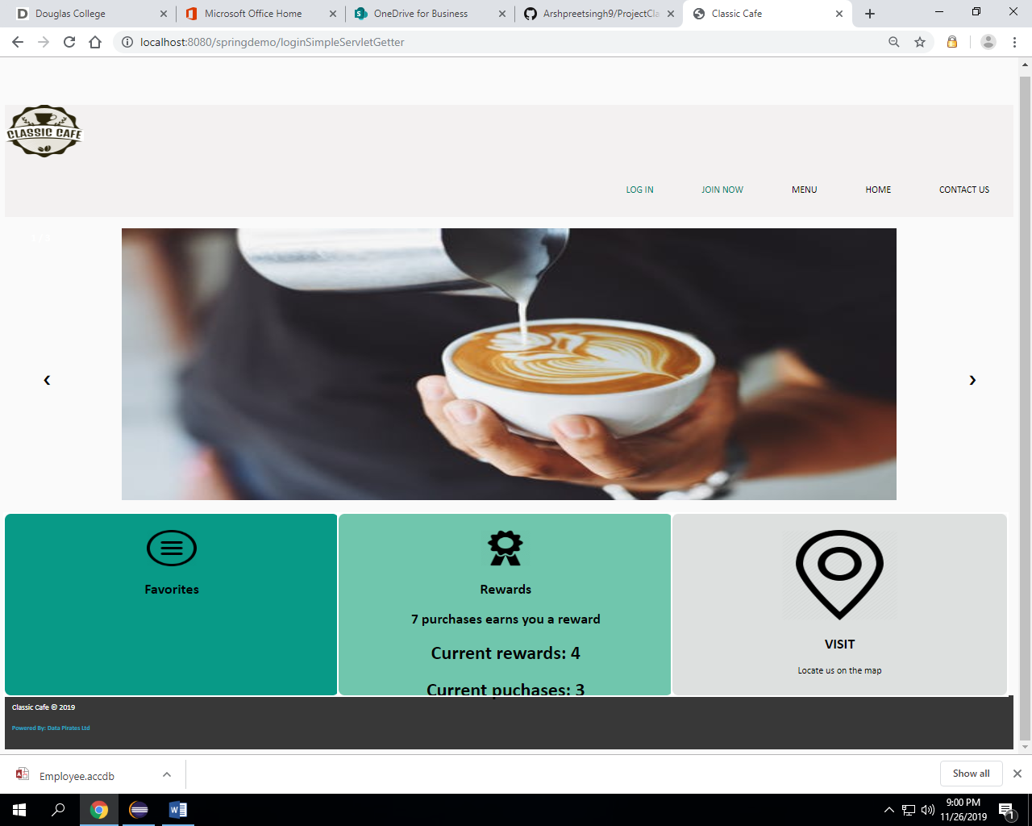
Login again: to see the updated purchases or rewards, user needs to login again:

Slide 14
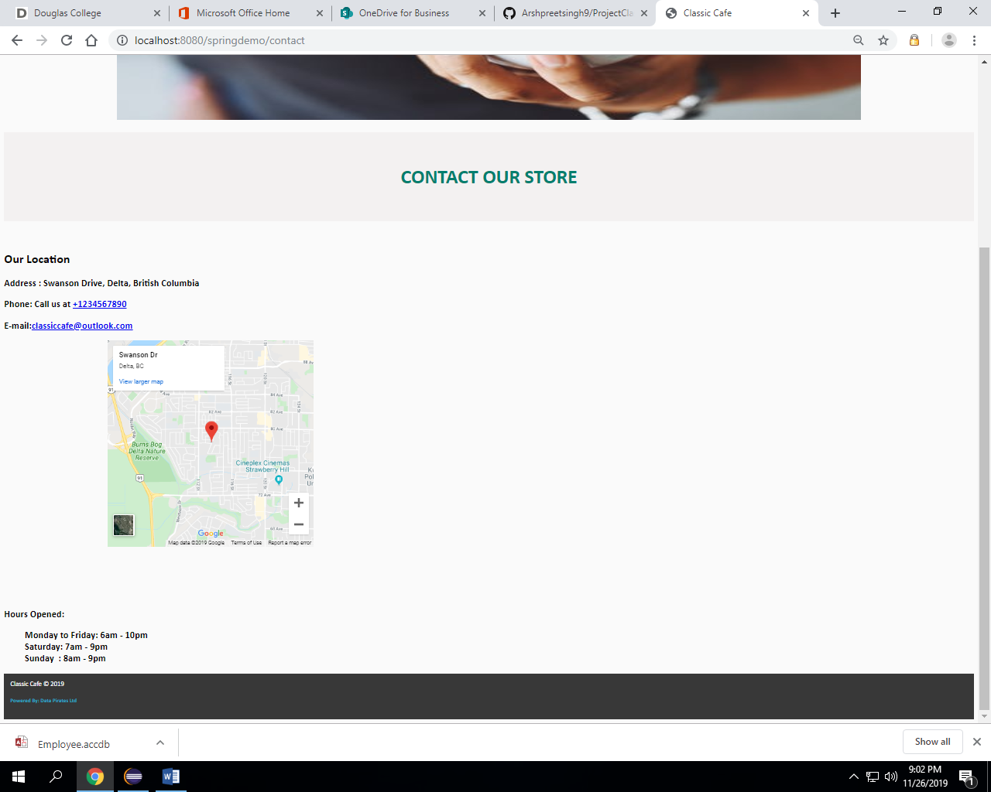
Contact:

Slide 15






Software and applications used:
VISUAL STUDIO
MICROSOFT ACCESS
TOMCAT
ECLIPSE
GITHUB
WHATSAPP

Slide 16

Project Risks
Cyber Attacks
System may not work on browser with updated versions.
The web application may not work properly due to website traffic

Slide 17
Thanks!
Any questions?

